Slide 1

Building PDF Reports with R
Anthony Osnacz

Slide 2

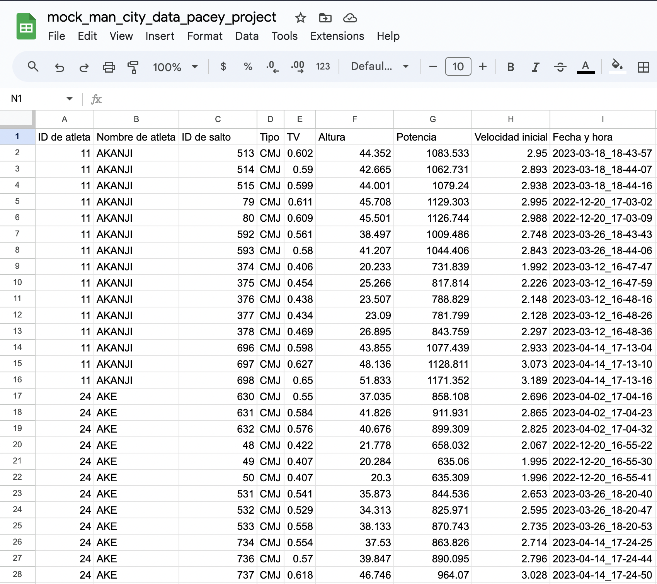
Project Goals
Build a PDF Report with mock Manchester City Data
Our make-believe coach wants to view the team’s jump height data from the latest test session, with context as to what the results mean,
In tabular format. They prefer the data to also show historical trends.
Our plan is to create this table with R! Our data can be found here!
Download this ^

Slide 3
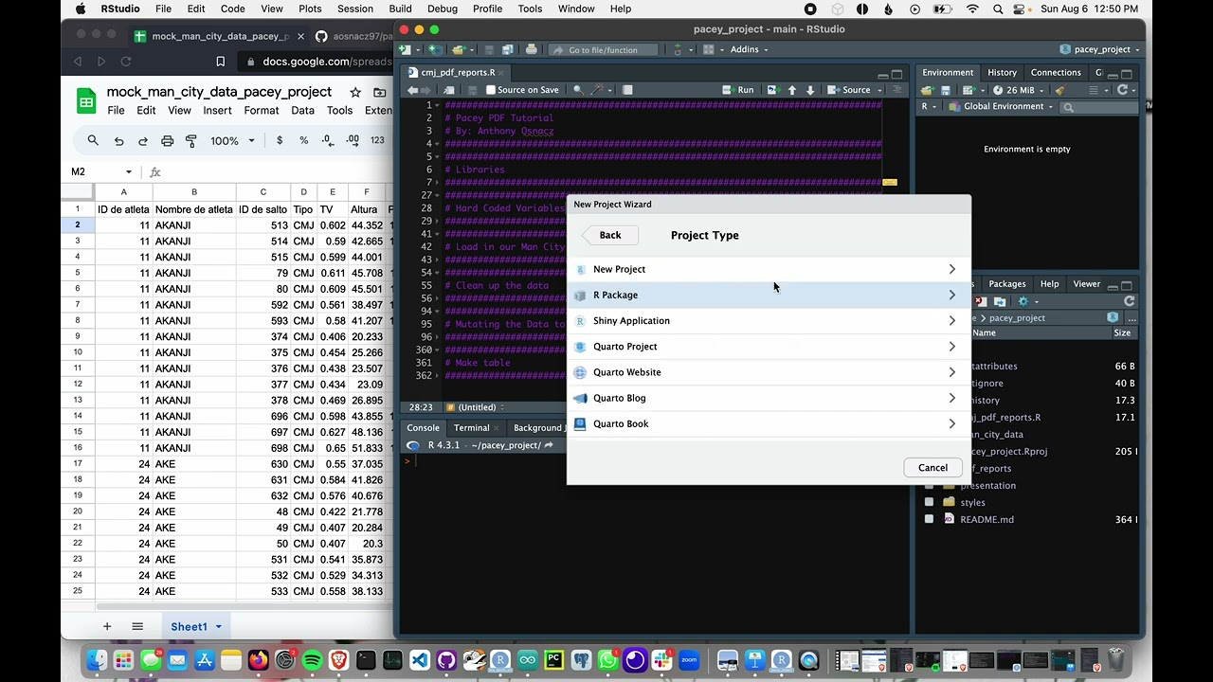
Video Tutorial
Step 1: Introduction
In this video we’ll get our project setup!

Slide 4
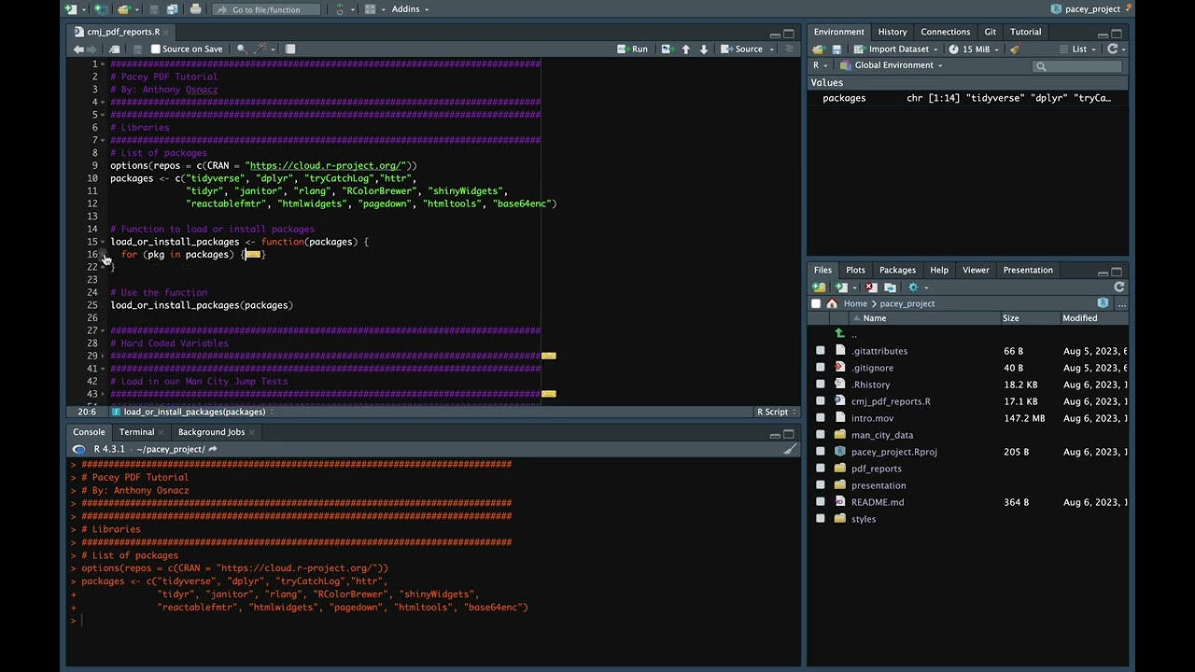
Video Tutorial
Step 2: Installing Libraries
In this video we’ll install and load our libraries!

Slide 5
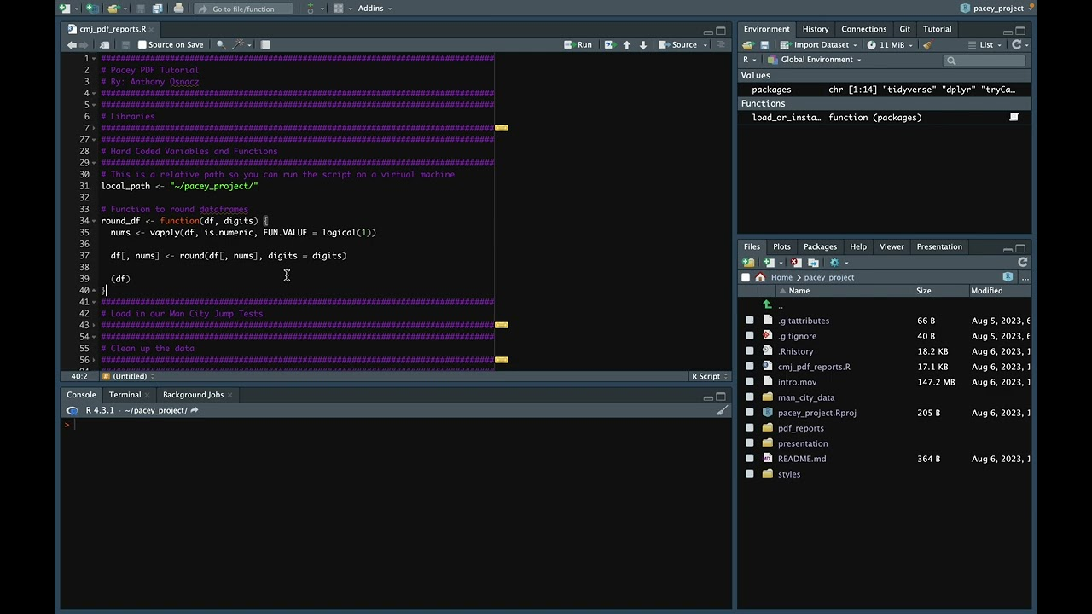
Video Tutorial
Step 3: Setting Variables and Creating Functions
In this video we’ll set our path variable and create a function!

Slide 6
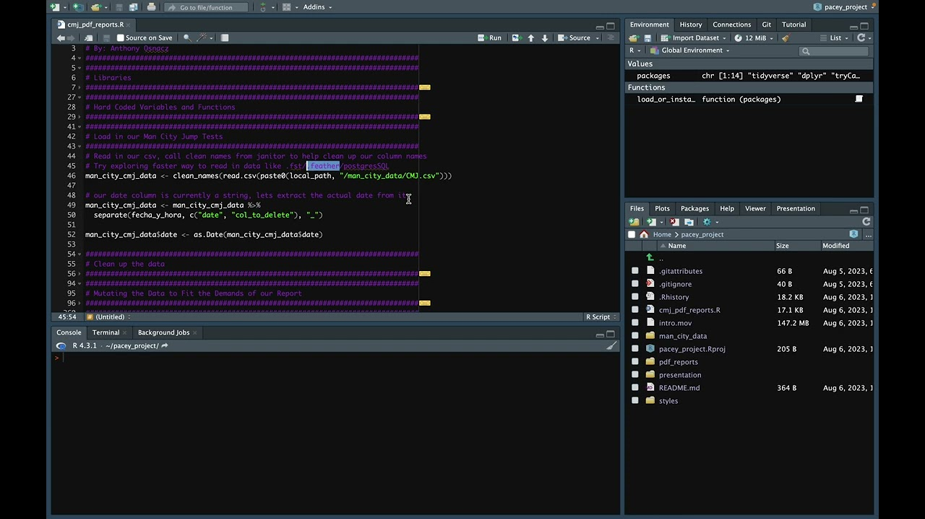
Video Tutorial
Step 4: Reading in Our Data
In this video we’re going read in our data from our Google Sheet!

Slide 7
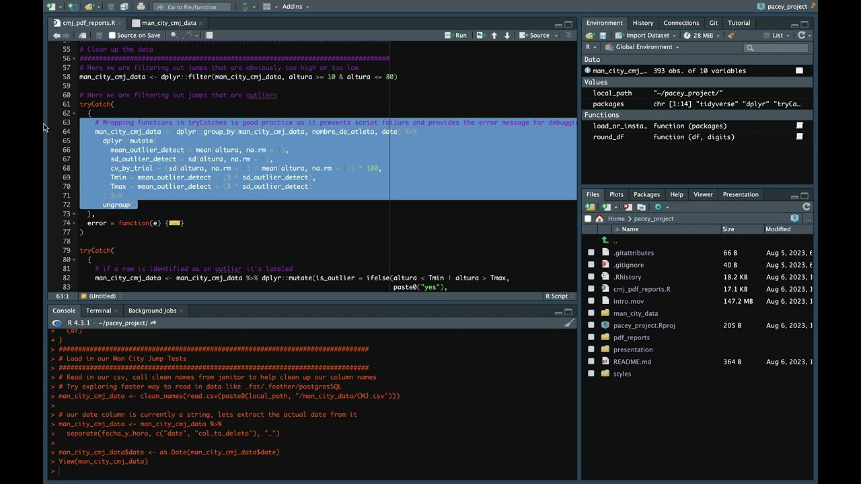
Video Tutorial
Step 5: Cleaning Our Data
In this video we’re going to be cleaning up our data!

Slide 8
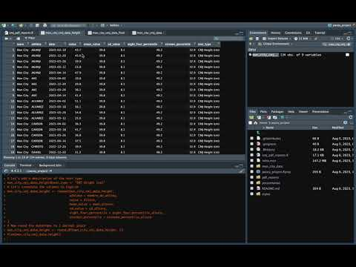
Video Tutorial
Step 6: Manipulating Our Data
In this video we’re going to be manipulating up our data !

Slide 9
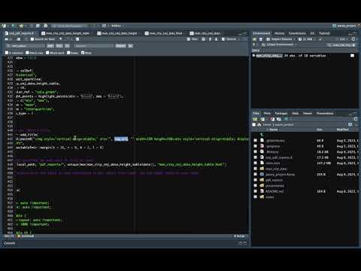
Video Tutorial
Step 7: Creating our Report
In this video we’re going to be finally creating our PDF Report!

Slide 10
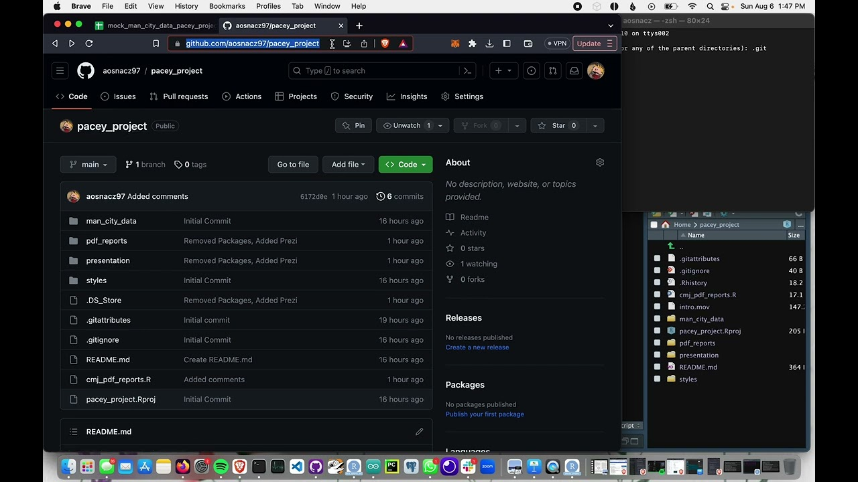
Video Tutorial
Step 8: Cloning my Repo on Github
This is an optional step. In this video I’ll show you how to clone repositories from Github!

